Slide 1
medCafe Tech Brief
Gail Hamilton and Jeff Hoyt
703-983-7855 • ghamilton@mitre.org
703-983-6241 • jchoyt@mitre.org
703-983-7043 • mgreer@mitre.org
MITRE Internal Information
For Limited External Release
Not approved for further distribution

Slide 2
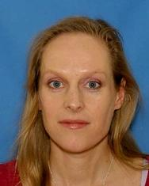
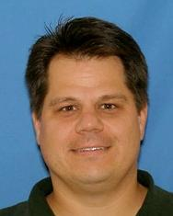
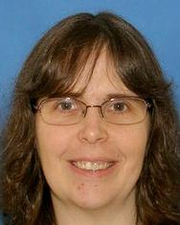
MedCafe People
Gail Hamilton (Pi) Jeff Hoyt (CoPi) Mary Greer
SME: Christian Donohue M.D.
VA Physician , Raleigh, Durham
National Primary Care Redesign Workgroup
Durham VA Systems Redesign Steering Committee
Durham VA Primary Care Redesign Committee
Notes:
Andy Gregorwitz: hData
Cheryl Clark: Medical Fact Extraction
David Harris: Categorization of discharge summaries PDFs
Christian Donohue M.D.:
National Primary Care Redesign Workgroup
Durham VA Systems Redesign Steering Committee
Durham VA Primary Care Redesign Committee
Dr. Donohue is currently a physician (since 2007) at the Department of Veterans Affairs, working at the Raleigh Clinic.
Jean Stanford, Mary Pulvemacher

Slide 3
Overview
Why Did We Do It?
How Did We Do It?
What Did We Do?
Why What We Did Matters!
Screen-shots
MedCafe Demo
Notes:
How: Architecture, designed to allow plug and play of components, demo how to add component
What: Wish List, Development Milestones, Future Plans
So What: Why the MedCafe design aligns well to the direction of EHR

Slide 4
MedCafe: Why Did We Do It?
Notes:
MedCafe Architecture, Separation of Data from Display, and a brief overview of how to add a new component simply

Slide 5

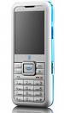



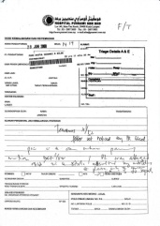
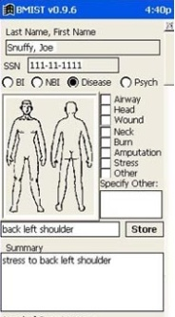


VA: The Current Workflow
Phone
Email
Fax
Vista
AHLTA
Outside Records
Has 15 minutes per patient
Notes:
They have, on average only 15 minutes to spend with each patient.
And have even less face time with a patient.
In this time they must
access the situation ,
to diagnose problem and
verify that old and new data confirms/ refutes this hypothesis
recommend treatment
To do this the doctor has to sift through a large amount of information, from various sources some of it not readily available.
These sources of information include:
VISTA – The system that they will currently be using to store patient records, or using as a messaging system
Email – generally Outlook
Fax – for any information that has been faxed from other clinicians or from outside sources
Phone – After a phone call, the physician has to write down the salient points of the call
And any scanned in records that are generically labeled “outside records”, and ,may include records from
AHLTA – The DoD medical system.
As a physician put it: “Everyday you need to search all these sources of information for data.”
Which leads to this…
All this information must be searched through and correlated in the physician’s head.
Which leads to this…

Slide 6
medCafe Goal
Goal: To demonstrate ways to improve interaction with patient records and increase efficiency to allow clinicians more time to interact with patient
Problem Addressed: Electronic Health Record (EHR) frustrations with:
Multiple data sources
“one size fits all” UI
Difficult to add new capabilities
Outside records/images
To demonstrate ways to give
caregivers more time to do what matters most
Notes:
Multiple Data sources. No standard – too many standards
EHRs don’t communicate seamlessly
One size – different people, different roles, need to see different aspects of patient health record. And each patient will have specific data and unique information.
No way to highlight what is important.
Outside Records: Dr estimates 80% workload is taken dealing with these records
Uncategorized scanned in pdfs. Generally labeled with radiologist name. No real way to distinguish what it shows without looking at it.
And many more issues….
CCoD Principles:
Allow for a composable interface, giving users maximum flexibility to configure the interface to their needs
Create a framework in which to run standalone composable components
Create a set of standalone components that can be composed together to build a complete patient record.
Use an accepted data standard for all communication to components
Allow for distributing and creation of templates that mirror physician's workflow

Slide 7
medCafe Technical Objectives
Develop an Open Source framework with:
Composable Architecture
Substitutable Components
Build a completely composable, easy to use patient record interface
Develop new ways for clinicians to interact with patient records
Design for flexibility, adaptability and evolution of the system
Provide relief from ‘pain points’ in common physician workflow
Provide an open framework
To allow users to build and add any desired capability
To provide more efficient ways for physicians to interact with patient records

Slide 8
MedCafe Objectives
We built a prototype to explore these issues
Web based (fully web 2.0)
Extensible architecture
CCoD¹ principles
Allow for Best of Breed
Listened to SMEs (Dr. Donohue)
¹Composable Capability on Demand
Notes:
Multiple Data sources. No standard – too many standards
EHRs don’t communicate seamlessly
One size – different people, different roles, need to see different aspects of patient health record. And each patient will have specific data and unique information.
No way to highlight what is important.
Outside Records: Dr estimates 80% workload is taken dealing with these records
Uncategorized scanned in pdfs. Generally labeled with radiologist name. No real way to distinguish what it shows without looking at it.
And many more issues….
CCoD Principles:
Allow for a composable interface, giving users maximum flexibility to configure the interface to their needs
Create a framework in which to run standalone composable components
Create a set of standalone components that can be composed together to build a complete patient record.
Use an accepted data standard for all communication to components
Allow for distributing and creation of templates that mirror physician's workflow

Slide 9
Scope
Due to limited funding and time, medCafe is a tightly scoped project
Prototype applying a modular system design to the healthcare domain. Specifically, examine:
Feasibility of composable approach
Engineering issues encountered
Potential future issues
As a result, many components typically present in production level systems were considered out of scope
Security (OAuth)
Role based access
Notes:
Why: History, Ideas, Goals and Objectives, Principles
How: Architecture, designed to allow plug and play of components, demo how to add component
What: Wish List, Development Milestones, Future Plans
So What: Why the MedCafe design aligns well to the direction of EHR

Slide 10
MedCafe: How Did We Do It?
Notes:
MedCafe Architecture, Separation of Data from Display, and a brief overview of how to add a new component simply

Slide 11

Small Pieces (Components)
Independent framework and many small, independent pieces
Allows use of “Best of Breed” components
Prevents vendor lock-in
Can replace part of the UI if it is insufficient or a better one appears
Easy to specialize
Purchase only what you need to cater to specialty
Smooth transition
Can start small and add capability over time
Notes:
Small components
Run standalone
Independent – can be added and dropped at will without affecting overall functionality
Allows Best of Breed

Slide 12

User Defined Interface
Default views (templates)
Start with default collection of components
Good for those who don’t want to customize
Clinician defined views
Some specialists, advanced users wish to customize their view for their patients
Per patient views
Some patients are not “fit the mold”
Modify a view for specific patient and save it
Speeds re-engagement with a patient
Notes:
Templates:
Give physicians starting point to build from :
quick way to acquire various commonly required data
Template will be a default collection of components, labeled according to clinicians needs – e.g. PTSD
Specialists – specific needs

Slide 13

Consistent Access to Data
All data sources are presented in an identical format
Allows all components to speak the same language
Components can access all data the same way
All data sources can be expressed through all available components
More component choices -> more data sources willing to play
More data sources -> more component developers
Notes:
We access the data the same way using hData
All components can display this data format.
Display can be changed – without changing data
Data can be changed without changing Display

Slide 14
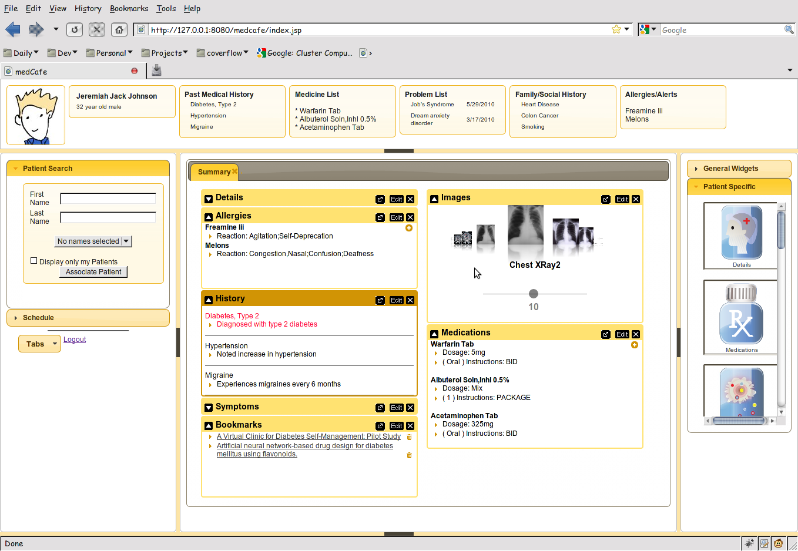
medCafe Interface
Top Pane: Coversheet containing commonly required patient data.
Left pane contains
Patient look up
and
scheduling functionality
Right hand pane contains list of
components that can be drag and dropped
into the center pane
Center pane contains composable patient record
Flexible 5 pane interface, adaptable to clinician’s needs. Panes can be hidden or shown.
Notes:
Framework overview:
5 major panes, North, South, etc,..
Can hide, show each pane.
Each pane can have multiple objects within it, such as tabs, widgets, sliders,treeviews etc,..

Slide 15
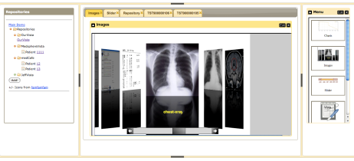





medCafe Architecture
Composable Framework
RESTful Web Services
Tabs
Coverflow
Date Slider
Image Viewers
Charts
Tomcat Web server
T
openVista
JAVA/ J2EE
Web Services
Additional
data servers
AJAX
medCafe Interface
Application server
Health-data server
medCafe architecture composed of 3 distinct, separable layers: front-end, application and data server.
Notes:
This shows the architecture of the framework that we have built.
We have three distinct pieces that make up the medcafe composable framework.

Slide 16
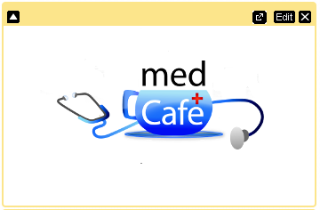




Adding A New Capability
Add New Component
Create and add a component + icon
Supply RESTful web URI for data
Add New Data Source
Determine if adaptor between hData and data source exists
If none exists, create adaptor to format target data source (hData)
Expose data source as RESTful service
Add RESTful URI to medCafe
View through default component
View using existing component
Add new component
A
Adaptor
Data source
URI = Uniform Resource Identifier

Slide 17
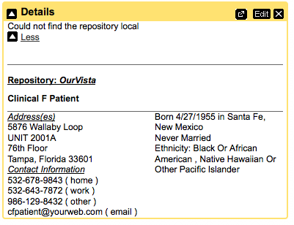
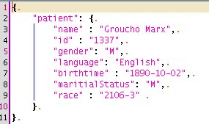
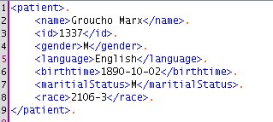
Converting Data to GUI
Converting hData to JSON
JavaScript is the language for dynamic web interfaces
Trivial mapping
Templates allow the transformation anywhere
Velocity and Velocity2JS
Remember all the formats (HTML, XML, JSON, etc.)?
Separates data from view
Component builder

Slide 18
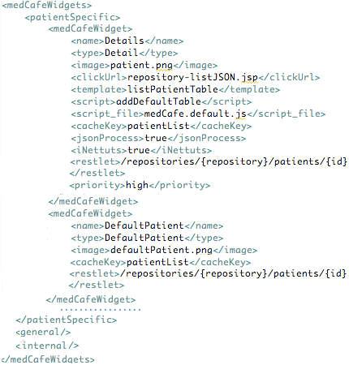
Adding a New Component
Specify Type
Patient, General, Internal
Data
Separate from Display
Restlet:
RESTful interface
Returns JSON data (XML/ hData)
Display
Separate from data
Template: (Velocity to JS) Formatting HTML from JSON
Script: Javascript for display formatting of HTML
Image
Optional: Defaults supplied
New components easily added
More refactoring planned….
Notes:
For nice display, specify all parameters.
But most parameters are optional.
Only need to specify 5, and 3 are user specified, i,.e. Name, Type, (maybe concatenate into one?)
Only two pieces of information really required, the RESTful URI, accessing the formatted data
And an image icon to distinguish this component.

Slide 19
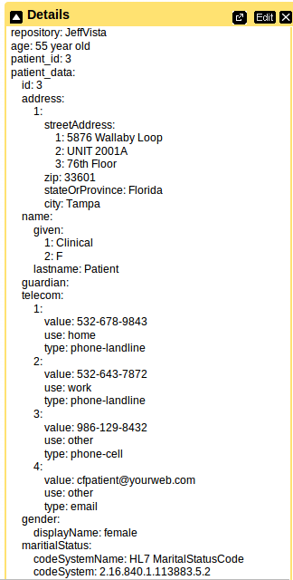
Customizing Components
Notes:
Same data displayed in two different components. The first, all parameters full specified, using nicely formatted Details widget.
The second, with minimal parameters specified, using Default Widget. Data is displayed, but not ‘pretty’.

Slide 20
MedCafe: What Did We Do?
Notes:
What did we do, Wish list from our SME, the project n=milestones, the components we developed and future plans

Slide 21
SME Wish List for Functionality
New Ways to Visualize Data
Coverflow for images
Timeline showing all appointments, visits, dates of medications, hospitalizations
Image functionality
Categorize and filter, Annotations, and share annotations , Highlight action, Tag documents with keywords and share tags
Patient Coversheet
Vital signs, Medications List, Allergies, Alerts, Past Medical History. Personal and Family (prioritized), Social History, Patient Photo, Future Appointments
New Modalities
Video, Sound (Electronic Stethoscope), Voice Recognition with transcription
Integration of categorized pdfs
And ability to add new data / tools as they become available

Slide 22
Project Development Milestones
Coverflow
Image Viewer
Date slider
Charts
Tables
Tree View
Image Zoom
Charts
Patient Data
Allergies
Medications
Sortable
Collapsable
Save state of patient data so physician can return on login
Security – login page
Patient search / selector
Scheduling
Drag and drop functionality
Introductory page directing user to select patient
Recent patient list
Multiple Repositories
Coversheet Header
Add additional data-sources: hData
PDF Text extraction of discharge summaries
Categorizing the data
Tooltip for more details
Fuzzy matching on categories (e.g. Smoker/ Smoking)
Timeline showing events, office visits etc,
Clickable to bring up associated chart/ Xray
Text editor with templates
Copy text between widgets
Filter on categories
Medication List
Allergy List
Multiple widgets per tab
Customizable look and feel
Patient “Dashboard”
Patient photos
Mobile device compatibility (iPad)
Save state of patient data so physician can return on login
Security – login page

Slide 23
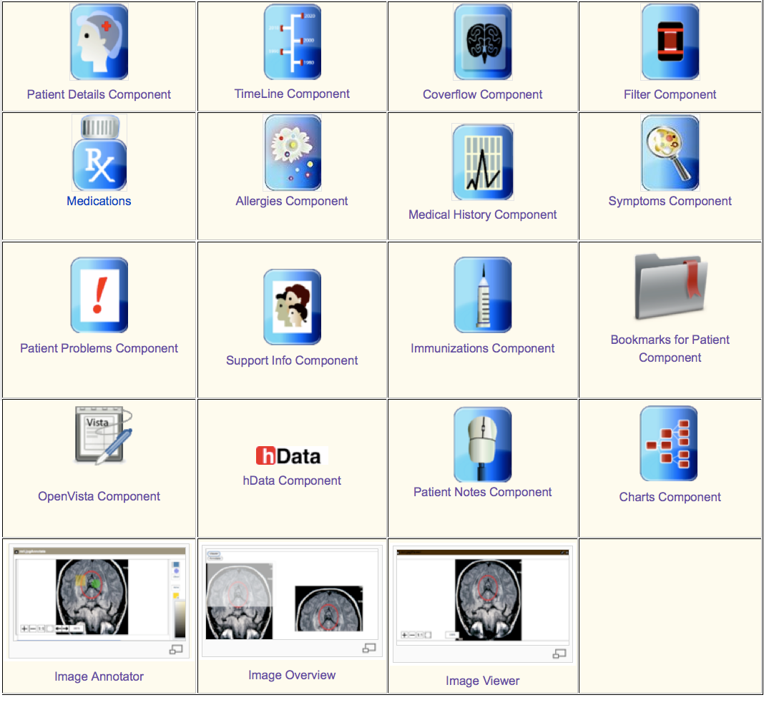
MedCafe Components

Slide 24
MedCafe Future Plans
Open sourcing of Code
Web presence
External medCafe server
Industry Reach out
White paper
Conference presentation
Document architecture
“Plugin Guide”

Slide 25
EHR: The Way Forward?
PCAST recommendation
Use meta-data tags for loose coupler
VA VistA Modernization
ACT-IAC Vista Modernization
Carnegie Mellon report recommending Open Source solution for VistA
Patient Centric approach
Clinical Groupware
ONC commits $60 million to 4 grants to solve EHR problems
Harvard SMART (Substitutable Medical Applications, Re-useable Technology) $15 million
“The approach could impact both the EHR industry…..(in) 1-3 years”¹
Clinical Groupware Consortium
New Data Delivery Platforms
iPad Apps, smart phone apps,..
Modularization Certification
HHS Certification process ("meaningful use of certified EHR technology”) for modular apps
CCHIT certification program for components of EHRs
¹http://www.thehealthcareblog.com/the_health_care_blog/2010/10/update-on-modular-ehr-technology-harvards-smart-research.html
Notes:
SMART: creating a “medical apps store” based on the iPhone/iPad model of substitutable applications running on a device or platform.
The approach could impact both the EHR industry and the federal regulatory and standards process, possibly within a relatively short period, i.e., 1-3 years, so we think it merits your attention.
ONC: Office of the National Coordinator for Health Information Technology

Slide 26
MedCafe : Why What We Did Matters!
Truly Modular EHR
Incorporating idea of “Substitutability”, allowing for Best of Breed
Leading edge prototype for Healthcare
Architecture arrived at with MITRE expertise / knowledge before rest of Healthcare
At the forefront of Healthcare IT
Ahead of any current implementation using this approach
Our budget: ~ 400k, SMART budget: 15 million
Scalable architecture
Prototype that shows viability of approach
iPad interaction via “Gestures”
Interfaces with OpenVista
As close to current VA repository as possible
Open source, business friendly license
Any vendor or organization can take code base and adapt/ enhance

Slide 27
MedCafe : Industry Feedback
From meeting with Open Health Tools
Rob Kolodner,
Chief Technology Officer for Open Health Tools
Former National Coordinator for Health IT
Skip McGaughey
(Executive Director) of Open Health Tools
Co Founder of Eclipse
“You solved a lot of the really hard problems”
“there are many who want to work to solve the next generation of the UI [user-defined GUIs], which you've already thought through most of”

Slide 28
MedCafe Screenshots

Slide 29
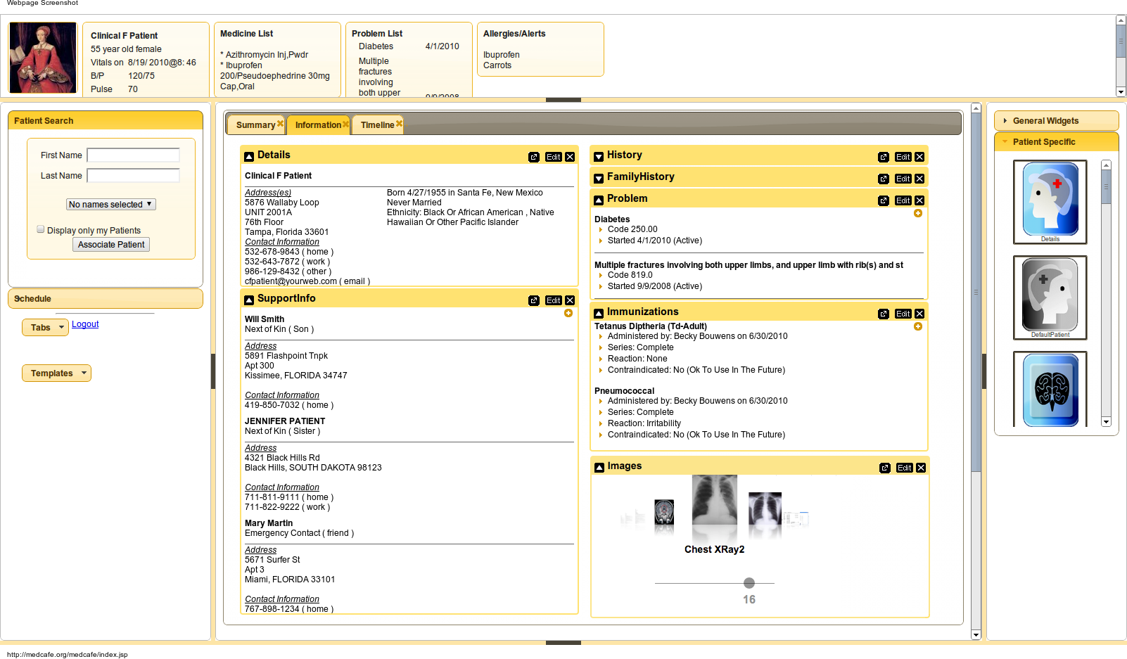
MedCafe: Screenshots Full Screen with Multiple Components
Notes:
MedCafe Architecture, Separation of Data from Display, and a brief overview of how to add a new component simply

Slide 30
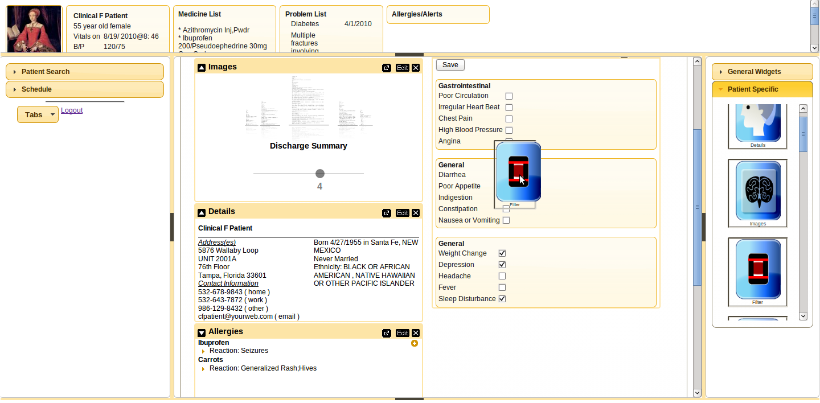
MedCafe: Screenshots Dragging a Component onto Patient Record
Notes:
MedCafe Architecture, Separation of Data from Display, and a brief overview of how to add a new component simply

Slide 31
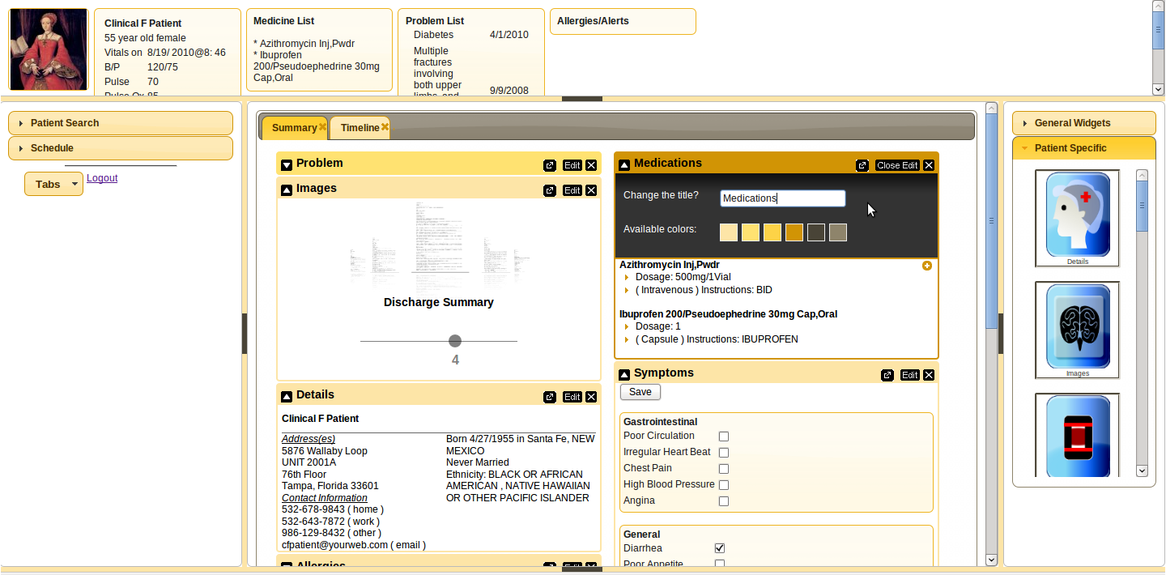
MedCafe: Screenshots Editing Component Title and Color
Notes:
MedCafe Architecture, Separation of Data from Display, and a brief overview of how to add a new component simply

Slide 32
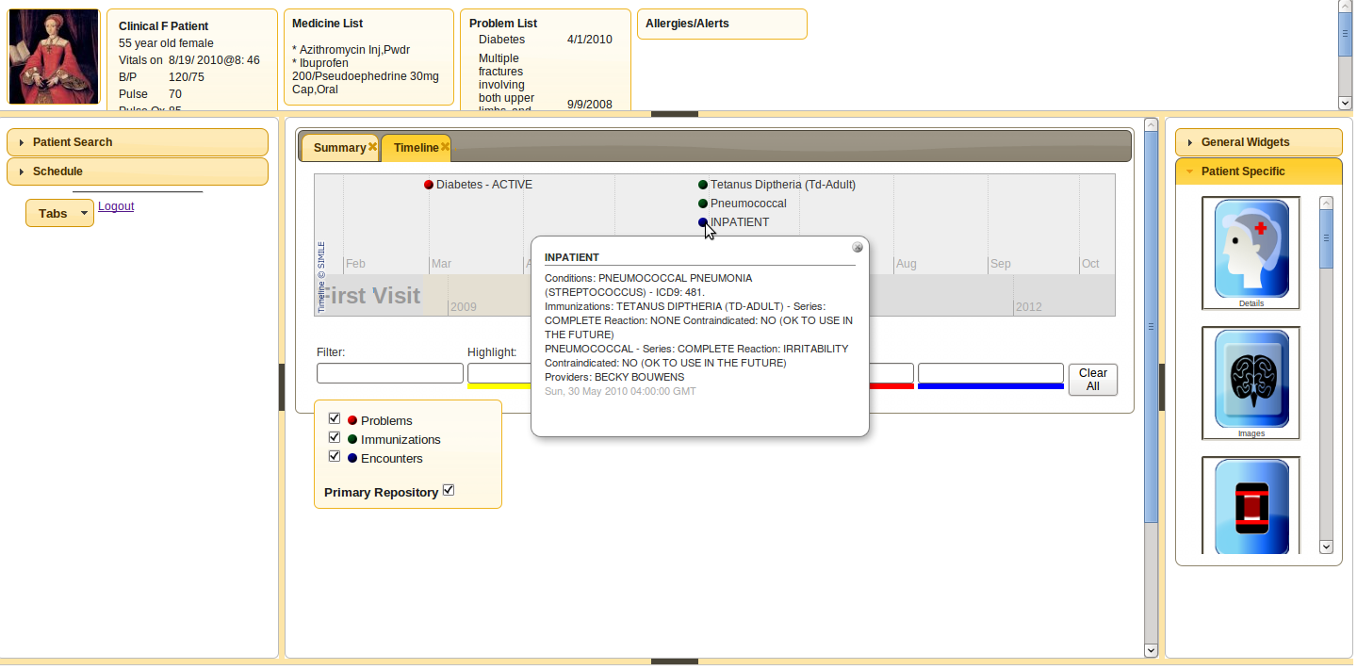
MedCafe: Screenshots Timeline Component
Notes:
MedCafe Architecture, Separation of Data from Display, and a brief overview of how to add a new component simply

Slide 33
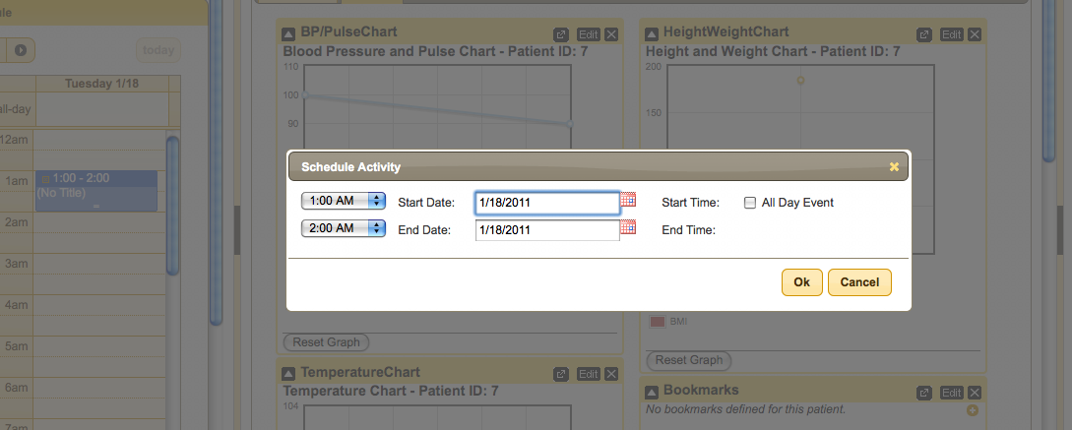
MedCafe: Screenshots Add Schedule
Notes:
MedCafe Architecture, Separation of Data from Display, and a brief overview of how to add a new component simply

Slide 34
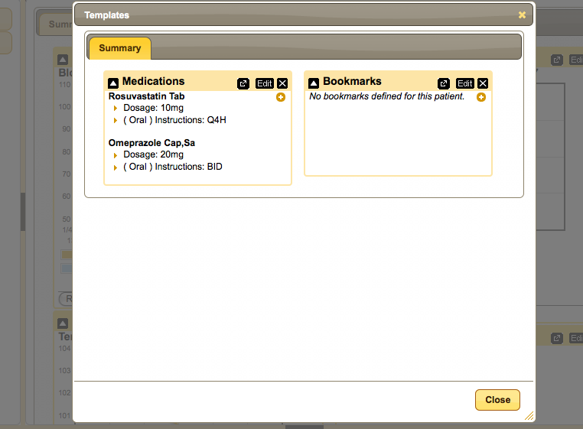
MedCafe: Screenshots View Template
Notes:
MedCafe Architecture, Separation of Data from Display, and a brief overview of how to add a new component simply

Slide 35
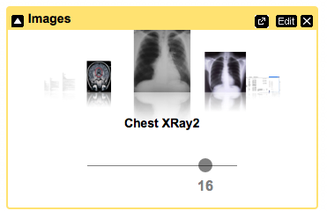
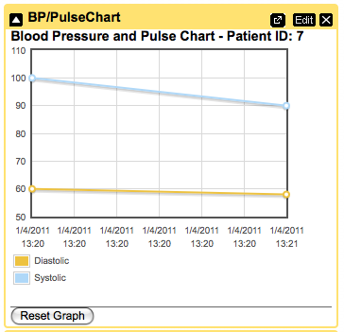
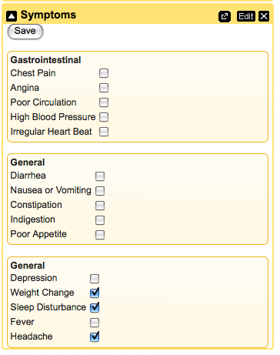
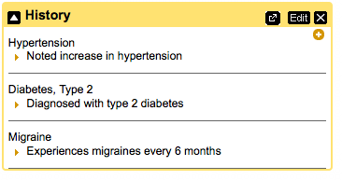
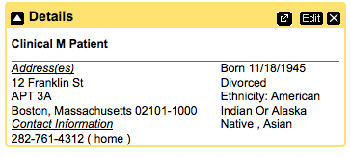
medCafe Sample Components

Slide 36
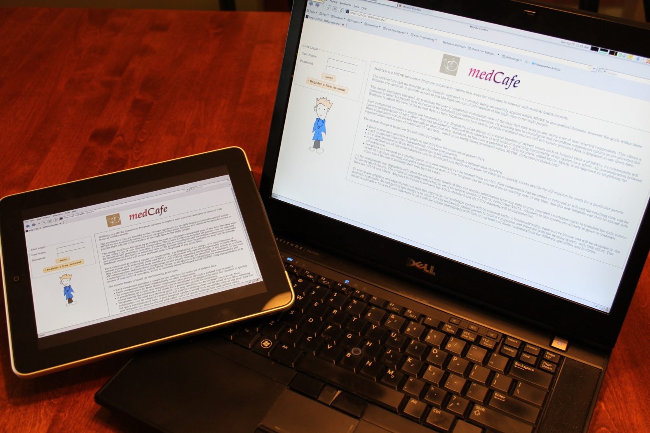
New Delivery Platforms
Notes:
iPad delivery through Browser. Added Touch gestures to allow for interfacing with data.

Slide 37
New Delivery Platforms
Notes:
iPad delivery through Browser. Added Touch gestures to allow for interfacing with data.

Slide 38
Demo
Notes:
Framework overview:
5 major panes, North, South, etc,..
Can hide, show each pane.
Each pane can have multiple objects within it, such as tabs, widgets, sliders,treeviews etc,..

Slide 39
Thank you!

Slide 40
medCafe & Patient Consent
Java* + Metadata
Metadata
medCafe UI
medCafe
wrapper
CDB
Java
XACML
Resu l tSe t
SQL+XACML
Record System
PEP
XML
SQL
Notes:
MedCafe + Patient Consent Management through enforceable policy,
“The goal of Patient Consent Management project is to develop an infrastructure that allows patients to communicate their privacy preferences to anyone maintaining health information on their behalf. These preferences indicate the situations under which the patient consents to share data (obviating the need to re-obtain consent for each transfer of data). We are developing a prototype that allows us to explore the policy issues that arise when scaling to a nationwide consent management system and to show how privacy preferences can be exchanged in an enforceable, automated, form.”

Slide 41
Possible Additional Components
Speech to Text
Transcribe doctors dictation notes
Alerts
Alert other clinicians through system, rather than email
Email, paper to patient automatically through system
Automatically call patient, leave text message
Note plugin
allow for cutting and pasting from other components

Slide 42
Collaborations
Meeting with Christian Donohue April 30th.
Continue working meetings with him
Feedback at http://mitrepedia.mitre.org/index.php/MedCafe
LAIKA (Andy Gregorowicz, existing work)
Provide data, hData
Automating Fact Extraction from Medical Records, (Cheryl Clark, proposed MSR)
Medical fact extraction to enhance “outside record” categorization
Security: Enforceable Specification of Policy (Peter Mork)
Using OpenVista instance
Multimodal Medical Data Capture and Representation (Qian Hu, existing MSR)
Speech to text capability
Notes:
We have been actively collaborating with both Andy Gregorowicz for hData.
And Cheryl Clark. Who have supplied us with pdfs of discahrge papers.
Are not yet ready to engage with Qian fpr Speech to text facility. Expect that this will happen 2nd to 3rd quarter.

Slide 43
SME Background
Work closely with SME
Christian Donohue, M.D. (Durham Medical Center, NC)
National Primary Care Redesign Workgroup
Durham VA Systems Redesign Steering Committee
Durham VA Primary Care Redesign Committee
Notes:
In April 2007 he started at the Department of Veterans. In early 2009 he was a asked to be a member of the VA’s national workgroup for primary care redesign. He sits on the Durham VA System Redesign committee and has been involved in several practice improvement projects for the Raleigh Clinic.
Dr. Donohue is currently a physician at the Department of Veterans Affairs, working at the Raleigh Clinic. His qualifications include attending medical school at Tufts University in Boston, residency at Thomas Jefferson University Hospital in Philadelphia, and assistant professorship at Duke University Medical Center.
He currently is a member of the VA’s national workgroup for primary care redesign, since early 2009, when he was asked to become a member. He sits on the Durham VA System Redesign committee and is involved in several practice improvement projects for the Raleigh Clinic.

Slide 44
Open Source
Open source repositories:
Open Health Tools: https://projects.openhealthtools.org/sf/sfmain/do/home
Open Source EHR in Use
FreeMED
OpenEMR
OpenEMR Current
OpenEMR Virtual Appliance
FreeB
SmartCare
Xchart
OpenMRS
Open Dental Software
ClearHealth

Slide 45
MedCafe Architecture
MedCafe Data
RetrievePatient.jsp
CachePatient.jsp
JSON
PatientCache Java Object
List of RESTful URIs
DataSouce.xml
<XML>
MedCafe Display
MedCafe Component
PatientCache Java Object
JSON Data
HTML
Widget Wrapper
(innettus.js)
Javascript for
Component
Velocity to JS Template
WidgetList <XML>

